Slide 1



Team Syncura AI: Big Data Health Science Case Competition 2025
Presenter: Saydain Sheikh
Shashankk Shekar Chaturvedi
Prayash Das

Slide 2

Section 1
Project Overview and Methodology

Slide 3





Objectives and Goals of the Competition
02
01
03
Enhanced Collaborative Skills
Practical Application of Knowledge
Encouragement of Innovative Solutions
The competition fosters teamwork, allowing students to develop interpersonal skills and learn effective communication strategies essential for professional environments.
Participants engage in real-world data analysis, enhancing their ability to tackle complex healthcare challenges through practical experience and critical thinking.
Teams are motivated to explore creative methodologies and technologies, promoting the development of novel approaches to address pressing healthcare issues.

Slide 4


Dataset Description and Key Variables
Comprehensive Variable Mapping
The dataset includes a detailed mapping of key variables such as patient demographics, ART regimen components, and critical laboratory measurements, enabling robust analyses of treatment efficacy and patient outcomes in HIV management.

Slide 5





Overview of Dataset Variables
Patient Demographics Analysis
ART Regimen Details
Viral Load and CD4 Counts
The dataset encompasses critical patient demographic information, including age, gender, and ethnicity, which are essential for understanding treatment responses and tailoring ART regimens effectively.
Detailed mapping of ART regimen components, including drug codes and their corresponding labels, facilitates accurate identification and analysis of treatment patterns and outcomes in HIV management.
Key variables such as Viral Load (VL) and CD4 counts are included, providing vital insights into patient health status and the effectiveness of ART regimens in achieving viral suppression.

Slide 6



Classification of ART Regimens
Core Components Overview
Diversity of Regimen Combinations
Impact on Patient Outcomes
The classification of ART regimens is based on essential components, including base drug combinations, integrase inhibitors, and pharmacokinetic enhancers, which collectively influence treatment efficacy.
A total of 135 unique ART regimen combinations were identified, showcasing the variety of treatment options available and the importance of personalized therapy in HIV management.
Tailoring ART regimens to individual patient profiles, considering factors like co-morbidities and previous treatments, is crucial for optimizing adherence and minimizing side effects in HIV care.

Slide 7


Predictive Modeling Approach
01
02
Systematic Methodology Overview
Robust Evaluation Framework
The predictive modeling approach integrates advanced statistical techniques and machine learning algorithms to analyze patient data, enhancing the accuracy of health outcome predictions based on ART regimens.
A comprehensive evaluation framework utilizing multiple performance metrics, including ROC-AUC and F1-score, ensures the model's reliability and effectiveness in predicting patient health outcomes in HIV treatment.

Slide 8



Predictive Modeling Approach Overview
Feature Engineering Techniques
Data Splitting and Evaluation
Modeling Strategy with LightGBM
Effective feature engineering involves transforming baseline features such as gender, ethnicity, and regimen into one-hot encoded formats, enhancing model interpretability and performance in predictive analytics.
Implementing an 80/20 train/test split ensures robust model evaluation, with metrics like ROC-AUC providing critical insights into model accuracy and predictive capabilities in clinical settings.
Utilizing LightGBM for modeling allows for efficient handling of large datasets, with hyperparameter tuning via GridSearchCV optimizing model performance and leveraging GPU acceleration for faster computations.

Slide 9
Section 2
Results, Recommendations, and Future Directions

Slide 10


Model Evaluation and Performance Metrics
Importance of Comprehensive Metrics
Utilizing a variety of performance metrics ensures a holistic evaluation of model effectiveness, particularly in imbalanced datasets common in healthcare applications.
Clinical Relevance of Precision
High precision is critical in clinical settings to minimize misclassification, ensuring that patients receive appropriate ART regimens based on accurate predictions.
ROC-AUC as Discriminative Tool
The ROC-AUC metric serves as a vital indicator of a model's ability to distinguish between treatment responses, guiding clinical decision-making in patient management.

Slide 11



Model Results & Evaluation Summary
High Performance Metrics
Significant Feature Importance
Caveats in Data Interpretation
The model achieved near 99% accuracy, precision, recall, F1 score, and ROC-AUC, indicating exceptional predictive capability and reliability in assessing patient treatment outcomes.
Key demographic features, such as gender and ethnicity, alongside critical regimen components, were identified as influential factors, guiding personalized treatment strategies and improving patient care.
Caution is advised due to potential biases arising from very small patient counts in certain regimen groups, which may affect the generalizability of the model's findings.

Slide 12

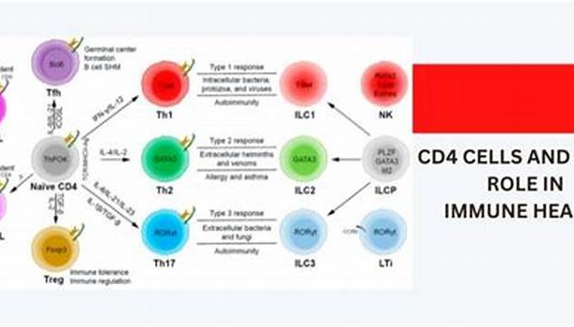

Outcome Definitions & Analysis
Initial Viral Load Suppression
Immunologic Success Measurement
Gold Standard Suppression
Achieving a viral load (VL) of ≤ 250 copies/mL is a critical milestone indicating the initial effectiveness of antiretroviral therapy in managing HIV infection.
Maintaining a CD4 count of ≥ 500 cells/mm³ is vital for assessing immunologic success, reflecting the immune system's recovery and resilience in response to effective ART.
A viral load of ≤ 50 copies/mL represents the gold standard for viral suppression, essential for long-term health and reducing transmission risk among HIV-positive individuals.

Slide 13
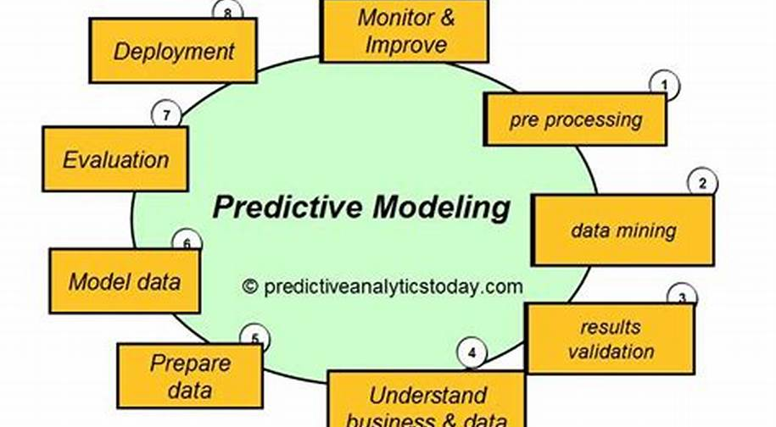



Strategic Recommendations for Implementation
Data-Driven Protocol Development
Customized Intervention Programs
Real-Time Monitoring Solutions
Establish clinical protocols that leverage predictive modeling insights, ensuring tailored standards of care that align with patient demographics and clinical outcomes for improved treatment efficacy.
Design targeted healthcare interventions that address demographic disparities, incorporating education and resources that resonate with specific populations to enhance engagement and support.
Implement advanced monitoring technologies that provide continuous oversight of patient health metrics, enabling timely interventions and adjustments to treatment regimens based on real-time data analysis.

Slide 14



Limitations and Future Research Opportunities
01
02
03
Bias in Synthetic Data
Need for Larger Samples
Inclusion of Qualitative Insights
The reliance on synthetic datasets may lead to skewed results, as they do not capture the full complexity of real-world patient experiences and conditions.
Future studies should prioritize larger sample sizes for ART regimens to ensure statistical significance and reliable insights into treatment effectiveness.
Future research should integrate qualitative methodologies to better understand patient experiences, enhancing the overall effectiveness of ART interventions.

Slide 15
Thank You

